Slide 1
Team No. 6
DATA MINING AND ANALYSIS
QUORA QUESTION PAIRS
Team members USN
Vishal MK 01FE15BCS232
Yogesh CH 01FE15BCS235
Yuyutsa S 01FE15BCS236

Slide 2
Problem Statement
Predicting which of the provided pairs of questions depicts the same meaning.

Slide 3
Detailed Description of dataset
id - the id of a training set question pair
qid1, qid2 - unique ids of each question (only available in train.csv)
question1, question2 - the full text of each question
is_duplicate - the target variable, set to 1 if question1 and question2 have essentially the same meaning, and 0 otherwise.

Slide 4
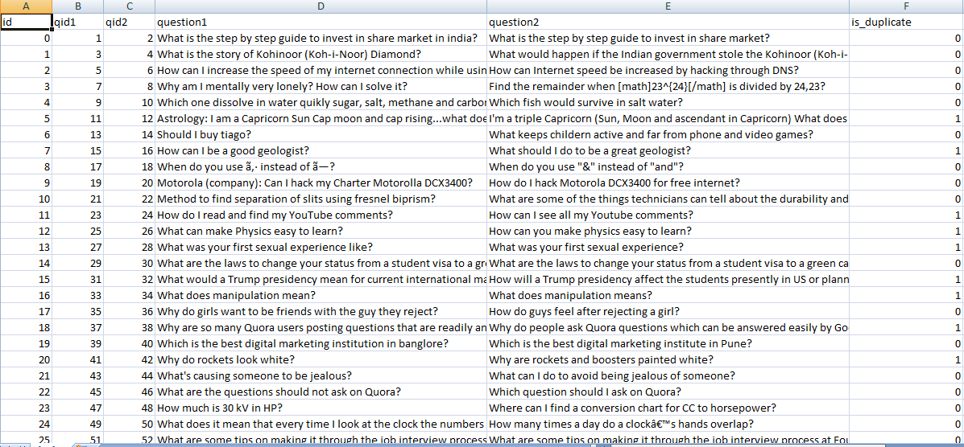
SNAPSHOT (Train.csv)

Slide 5
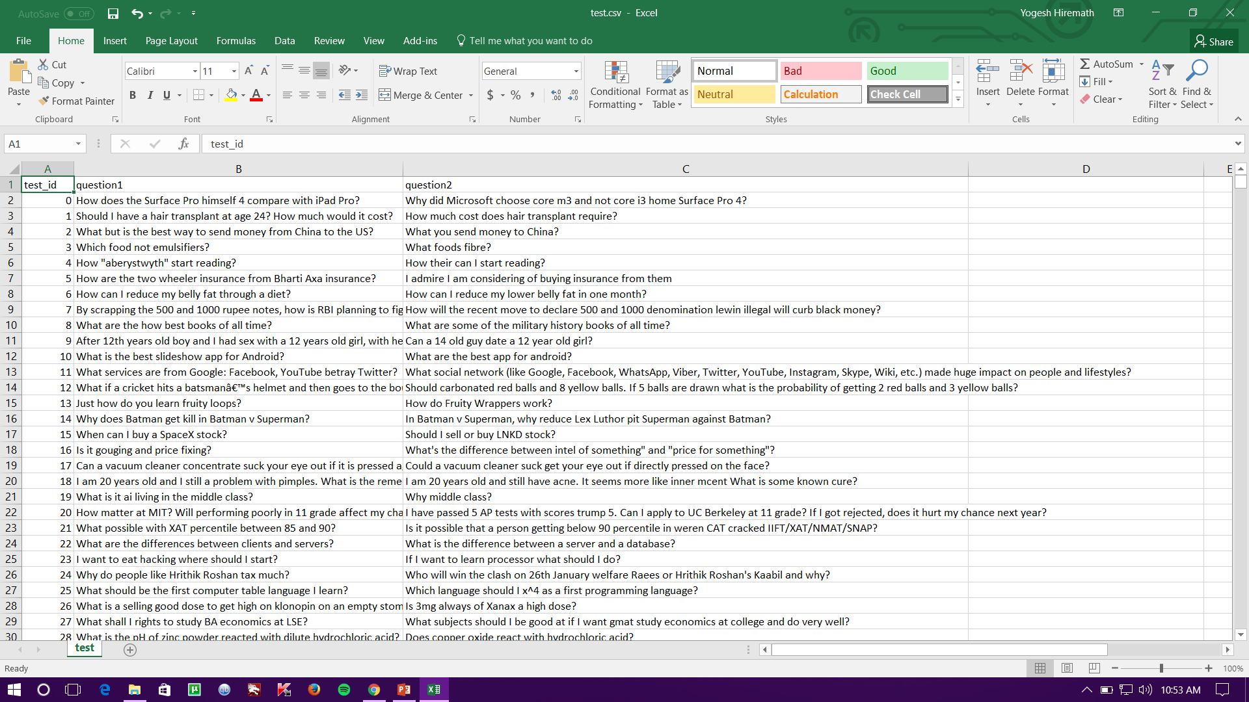
SNAPSHOT (Test.csv)

Slide 6
Dataset
Training_Dataset_v2.csv
Test_Dataset.csv
Training dataset size : 21 MB (4.04lacs X 6).
Test dataset size : 306 MB (10.4 lacs X 3).

Slide 7
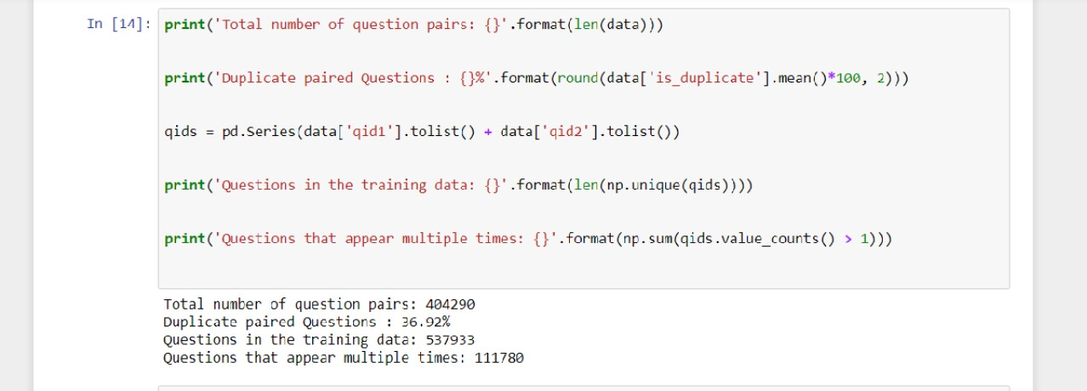
Data analysis
Most analysis here will be only on the training set, to avoid the auto-generated questions in Test.csv
Analysis of question appearance in training data set for finding features for the given dataset.

Slide 8
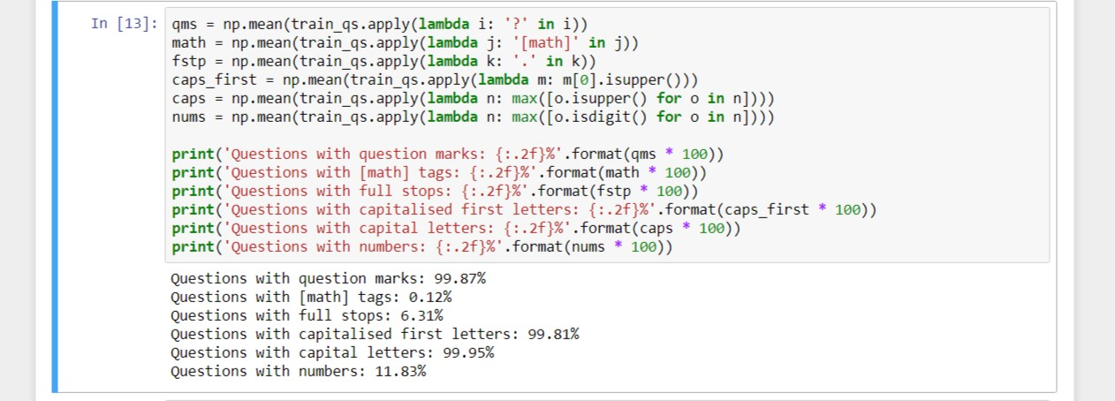
Semantic analysis
Analysis of the usage of different punctuation in questions - this may form a basis for some interesting features later on.

Slide 9
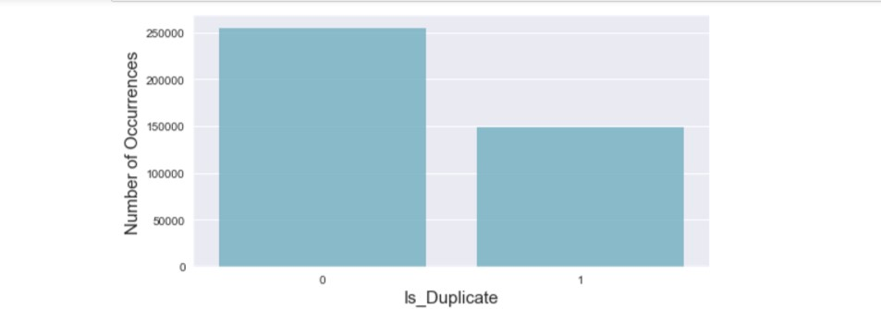
From the above graph 63% non-duplicate questions and 37% duplicate questions in the training data set.

Slide 10
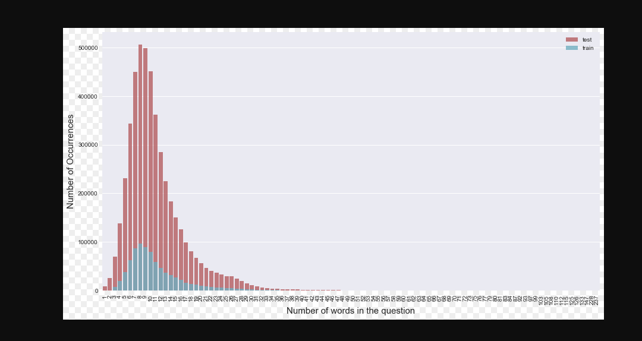
number of words distribution in the questions

Slide 11
From above graph
We can see that most questions have frequent word count of anywhere from 5 to 15 words both in test and training data.

Slide 12
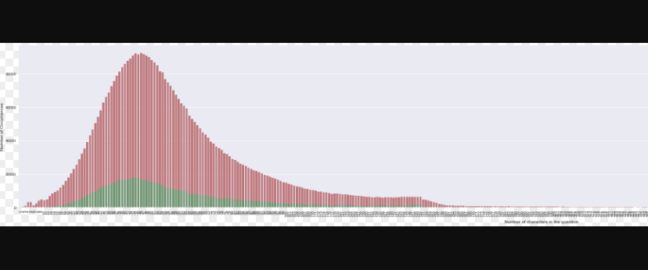
number of characters distribution in the questions

Slide 13
From above graph
We can see that most questions have anywhere from 15 to 150 characters in them. It seems that the test distribution is a little different from the train one, but not too much so (It can’t be told, if it is just the larger data reducing noise, but it also seems like the distribution is a lot smoother in the test set).
So what models or technique we apply to training dataset for finding duplicate question pairs it can also be applied to the test dataset for more accuracy in finding the question pairs(duplicate).

Slide 14
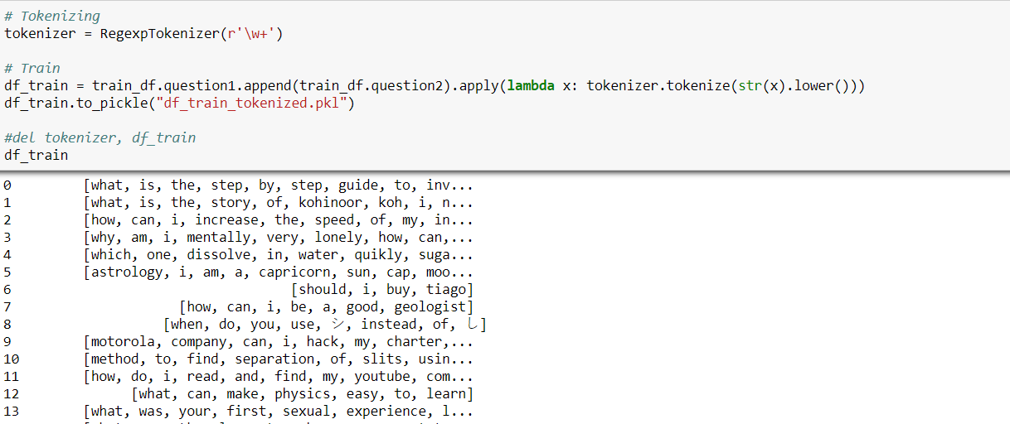
Pre-processing
Tokenizing the training dataset.

Slide 15
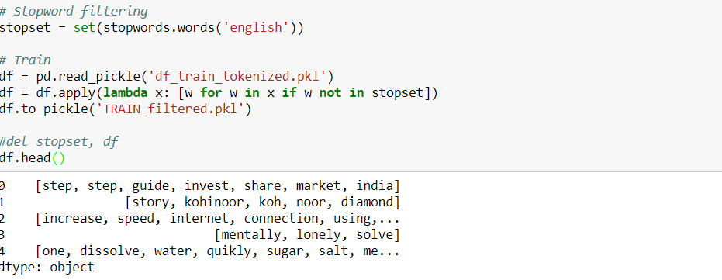
Pre-processing
Removing Stop-words from the training dataset.

Slide 16
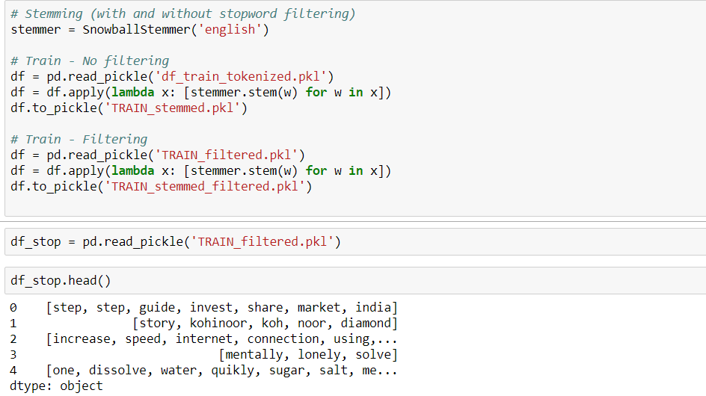
Pre-processing
Stemming the training dataset.
Eg: we’re ---> we are

Slide 17
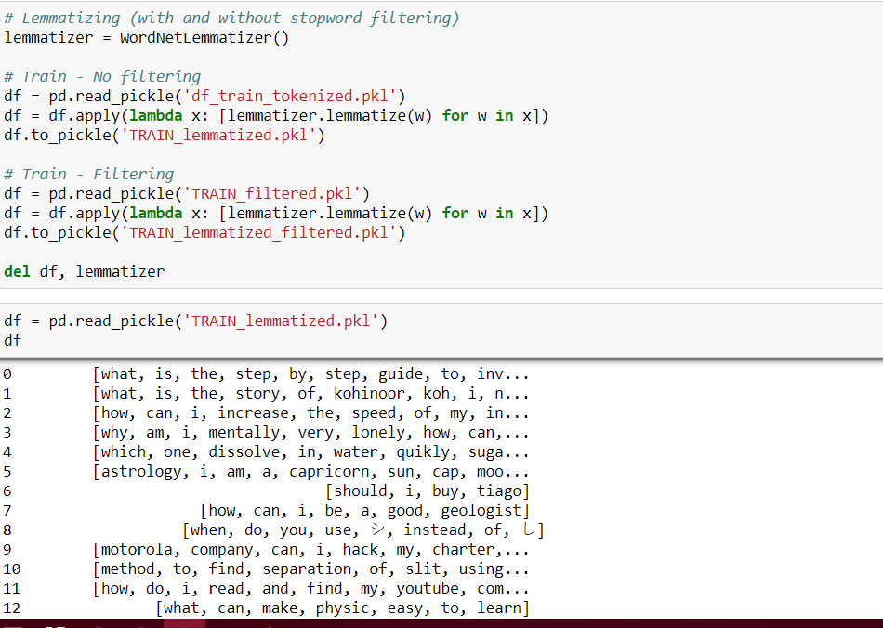
Pre-processing
Lemmatizing the training dataset.
Eg: car, cars,car’s,cars’ → car

Slide 18
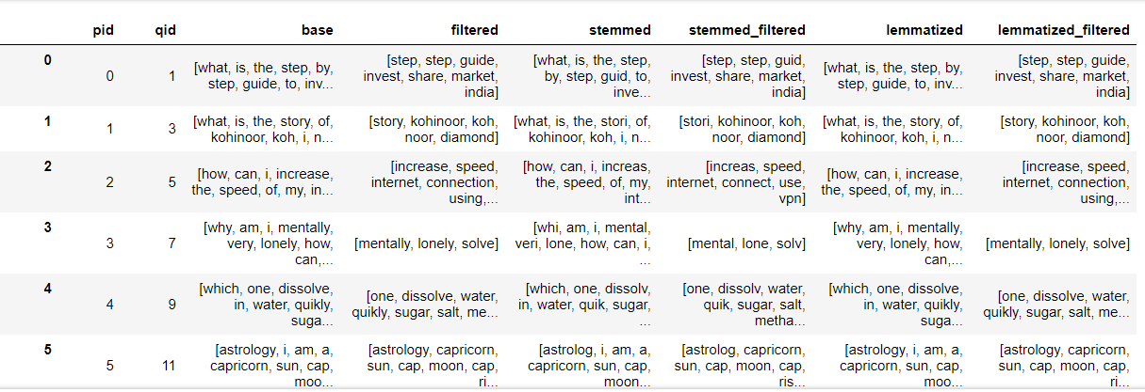
Pre-processing
After tokenizing, stopword removal, stemming and lemmatized of training dataset.

Slide 19
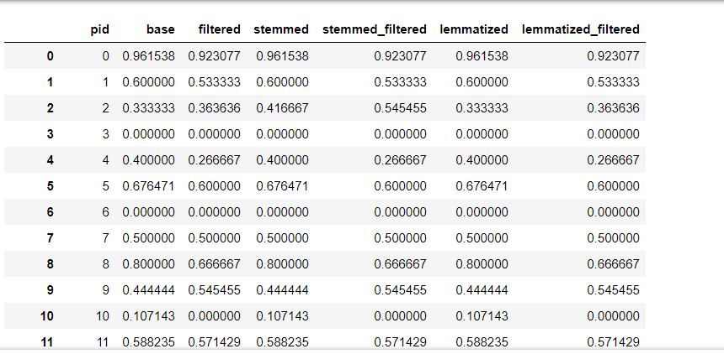
Pre-processing
Converted word share percentage of question pairs in training dataset Normally (without using any algorithm).

Slide 20
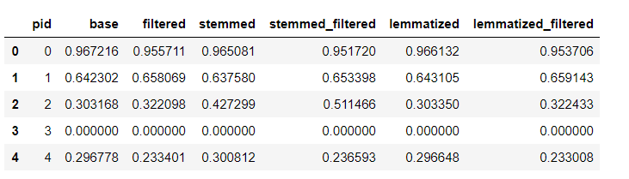
Pre-processing
Converted word share percentage of question pairs in training dataset using TF-IDF (Term frequency and Inverse Document Frequency) algorithm.

Slide 21
Fitting the training dataset into model
Splitting the training dataset into 90% training data and 10% testing data randomly

Slide 22
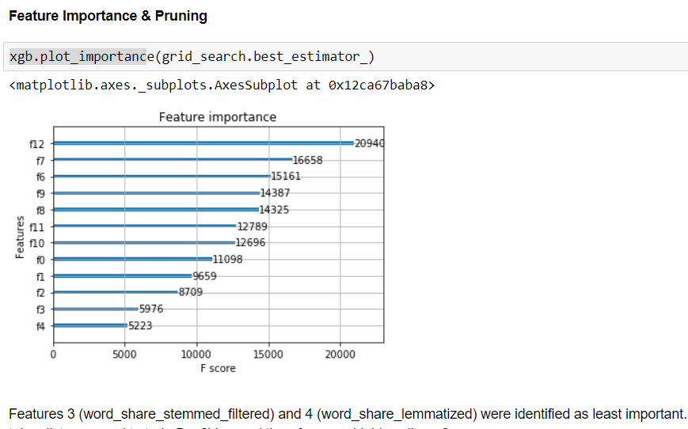
Feature Importance and Pruning
Using XGBoost plotted graph for each features donation for classification of question pairs.
With F – score ( Precision and Recall )
We can say that feature 3 and feature 4 are least importance.

Slide 23
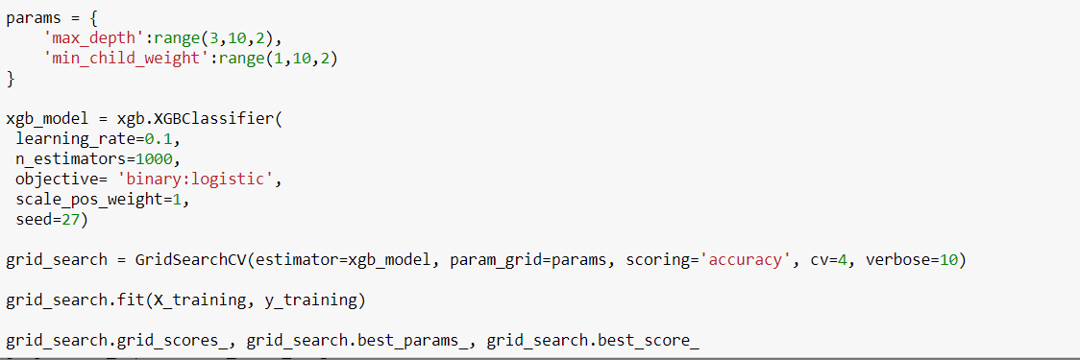
Fitting the training dataset into model
Firstly using Logistic regression model with XGBoost algorithm for increasing accuracy with parameter tuning with GridSearchCV algorithm.
And accuracy was 73.89%

Slide 24
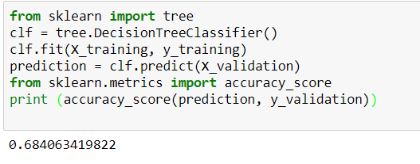
Fitting the training dataset into model
Using Decision tree Classifier
We got accuracy as 68.40%.

Slide 25
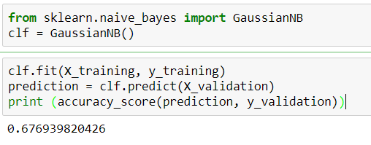
Fitting the training dataset into model
Using Naïve_Bayes model
We got accuracy as 67.69%.

Slide 26
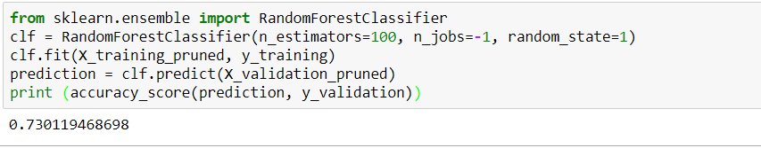
Fitting the training dataset into model
Using Random Forest Classifier
We got accuracy as 73.11%.
Which also used by Quora website for predicting Similar question pairs.

Slide 27
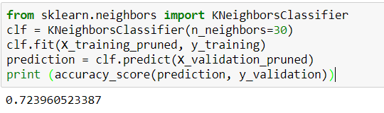
Fitting the training dataset into model
Using Nearest Neighbor Classifier
We got accuracy as 72.39%.

Slide 28
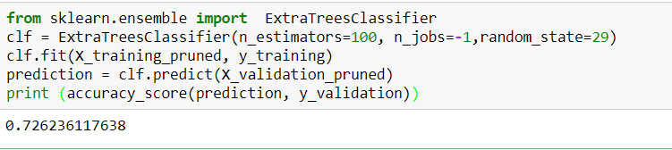
Fitting the training dataset into model
Using Extra Trees Classifier
We got accuracy as 72.62%.

Slide 29
Thank you

